Slide 1
Stock Trading App
The useEffects

Slide 2
Planning
Project Selection
5 mins
Project We Picked
API Selection
Luck
Batch requests

Slide 3
Sketches, Notes, Diagrams, MSCW
Must Have Current Value Performance Trends Ability to Retrieve Data From APIs | Should Have View chart of current values Remove Shares
Could Have Cash Count Crypto Assets Filter by Time Intervals Additional Metrics (Sharpe ratios etc) | Won’t Have Ability to Trade Stocks Authentication Encryption Stock Predictions

Slide 4
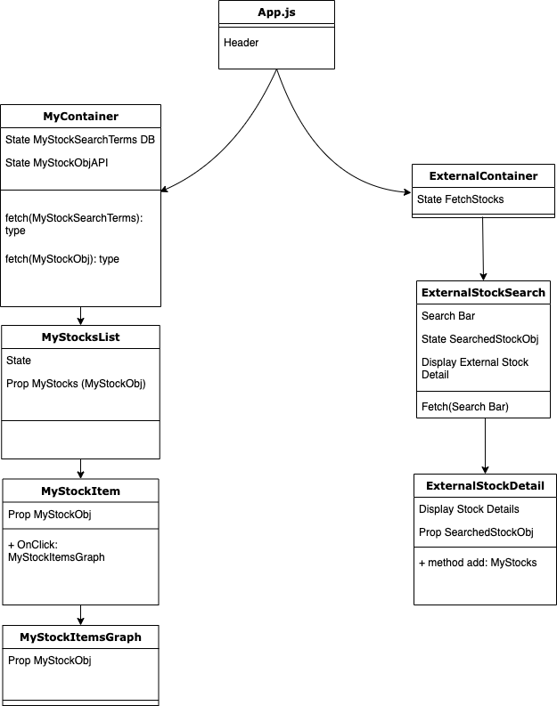
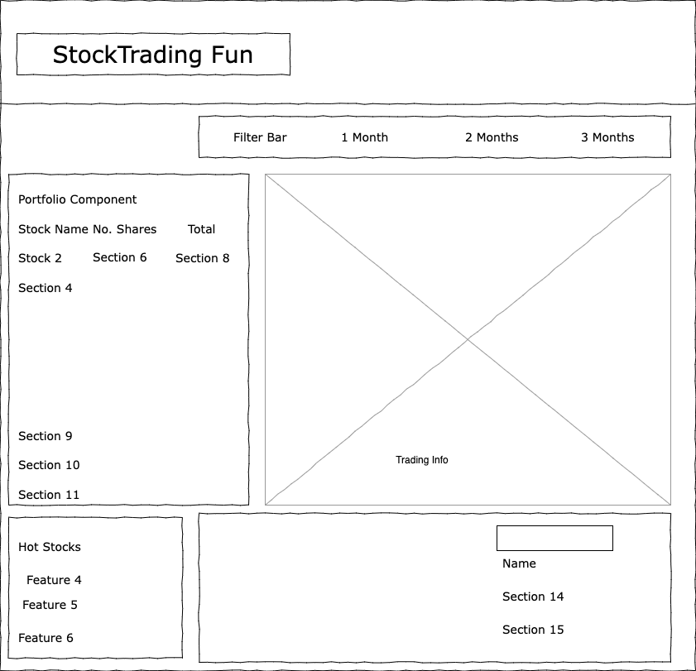
Planning, Diagrams

Slide 5
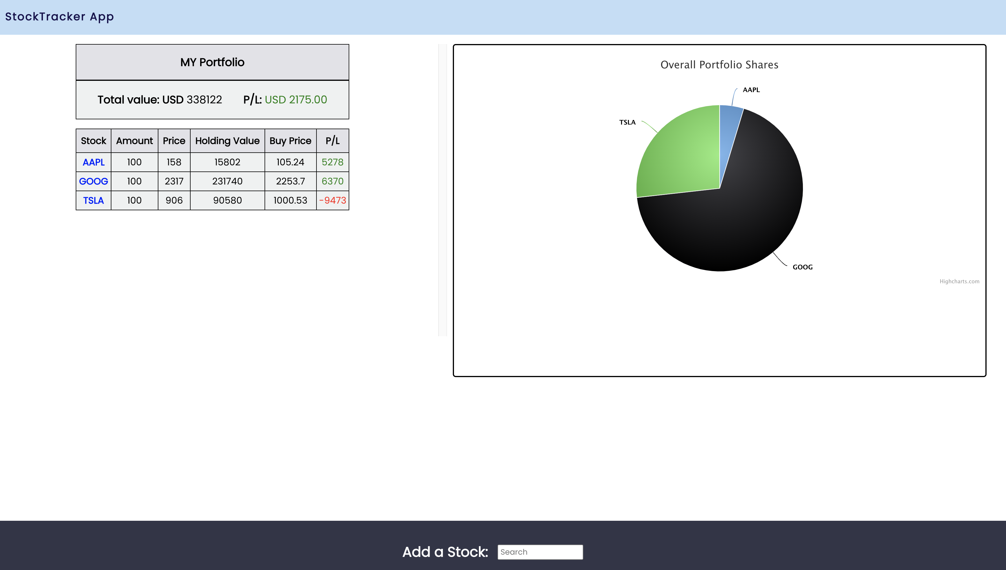
Demo

Slide 6
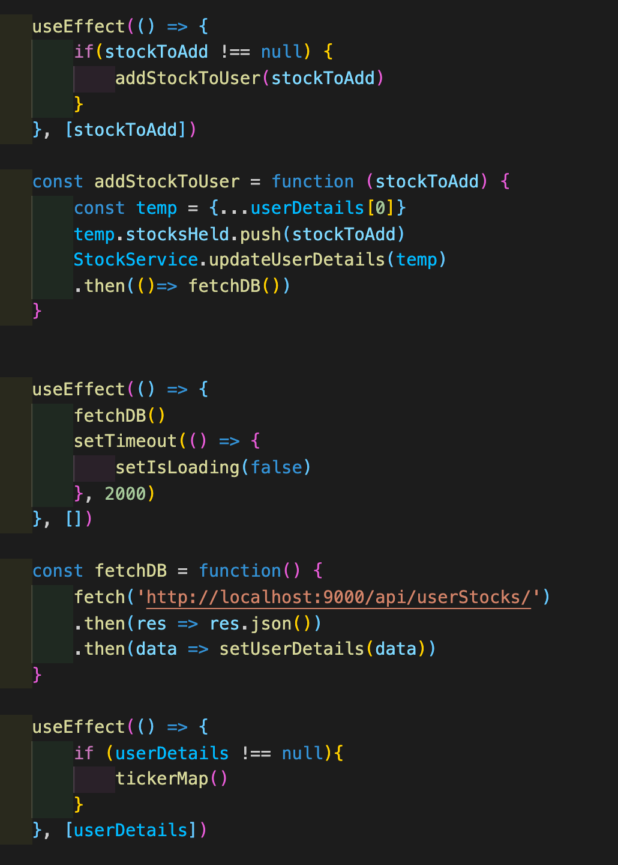
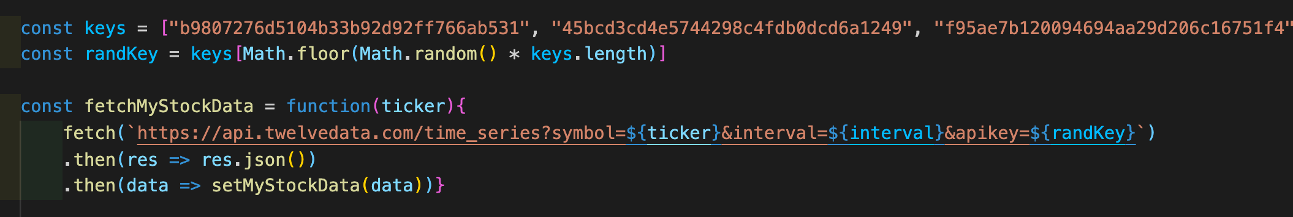
Code We’re Proud Of

Slide 7
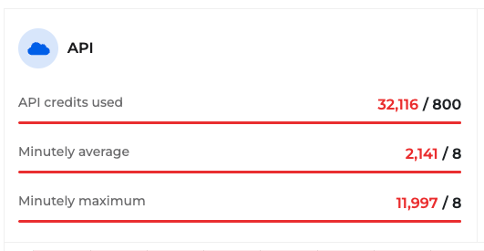
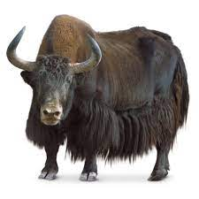
Main Learning Points
Pick APIs Carefully
Always make sure your useEffect isn’t going to go rogue
Take time, don’t let code runaway
Charts

